Slide 1
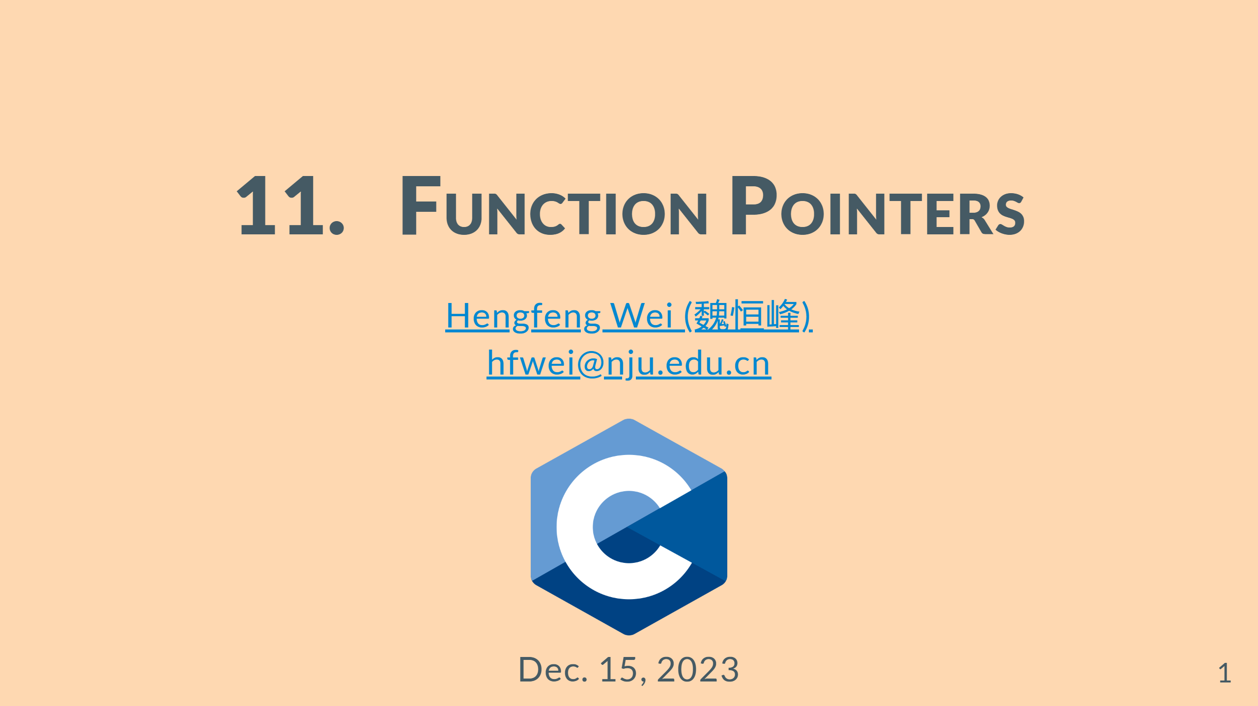

Slide 2
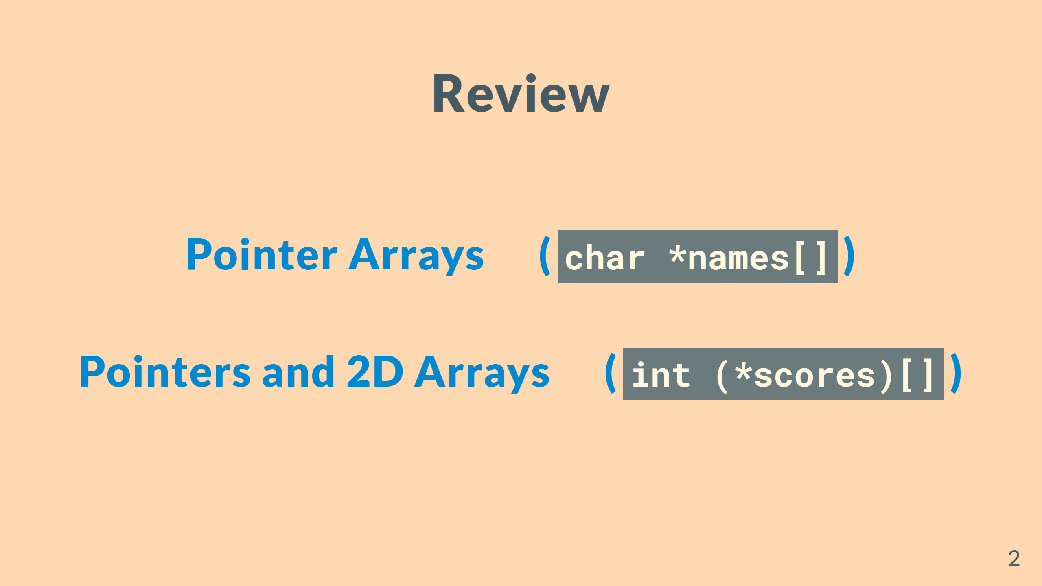

Slide 3
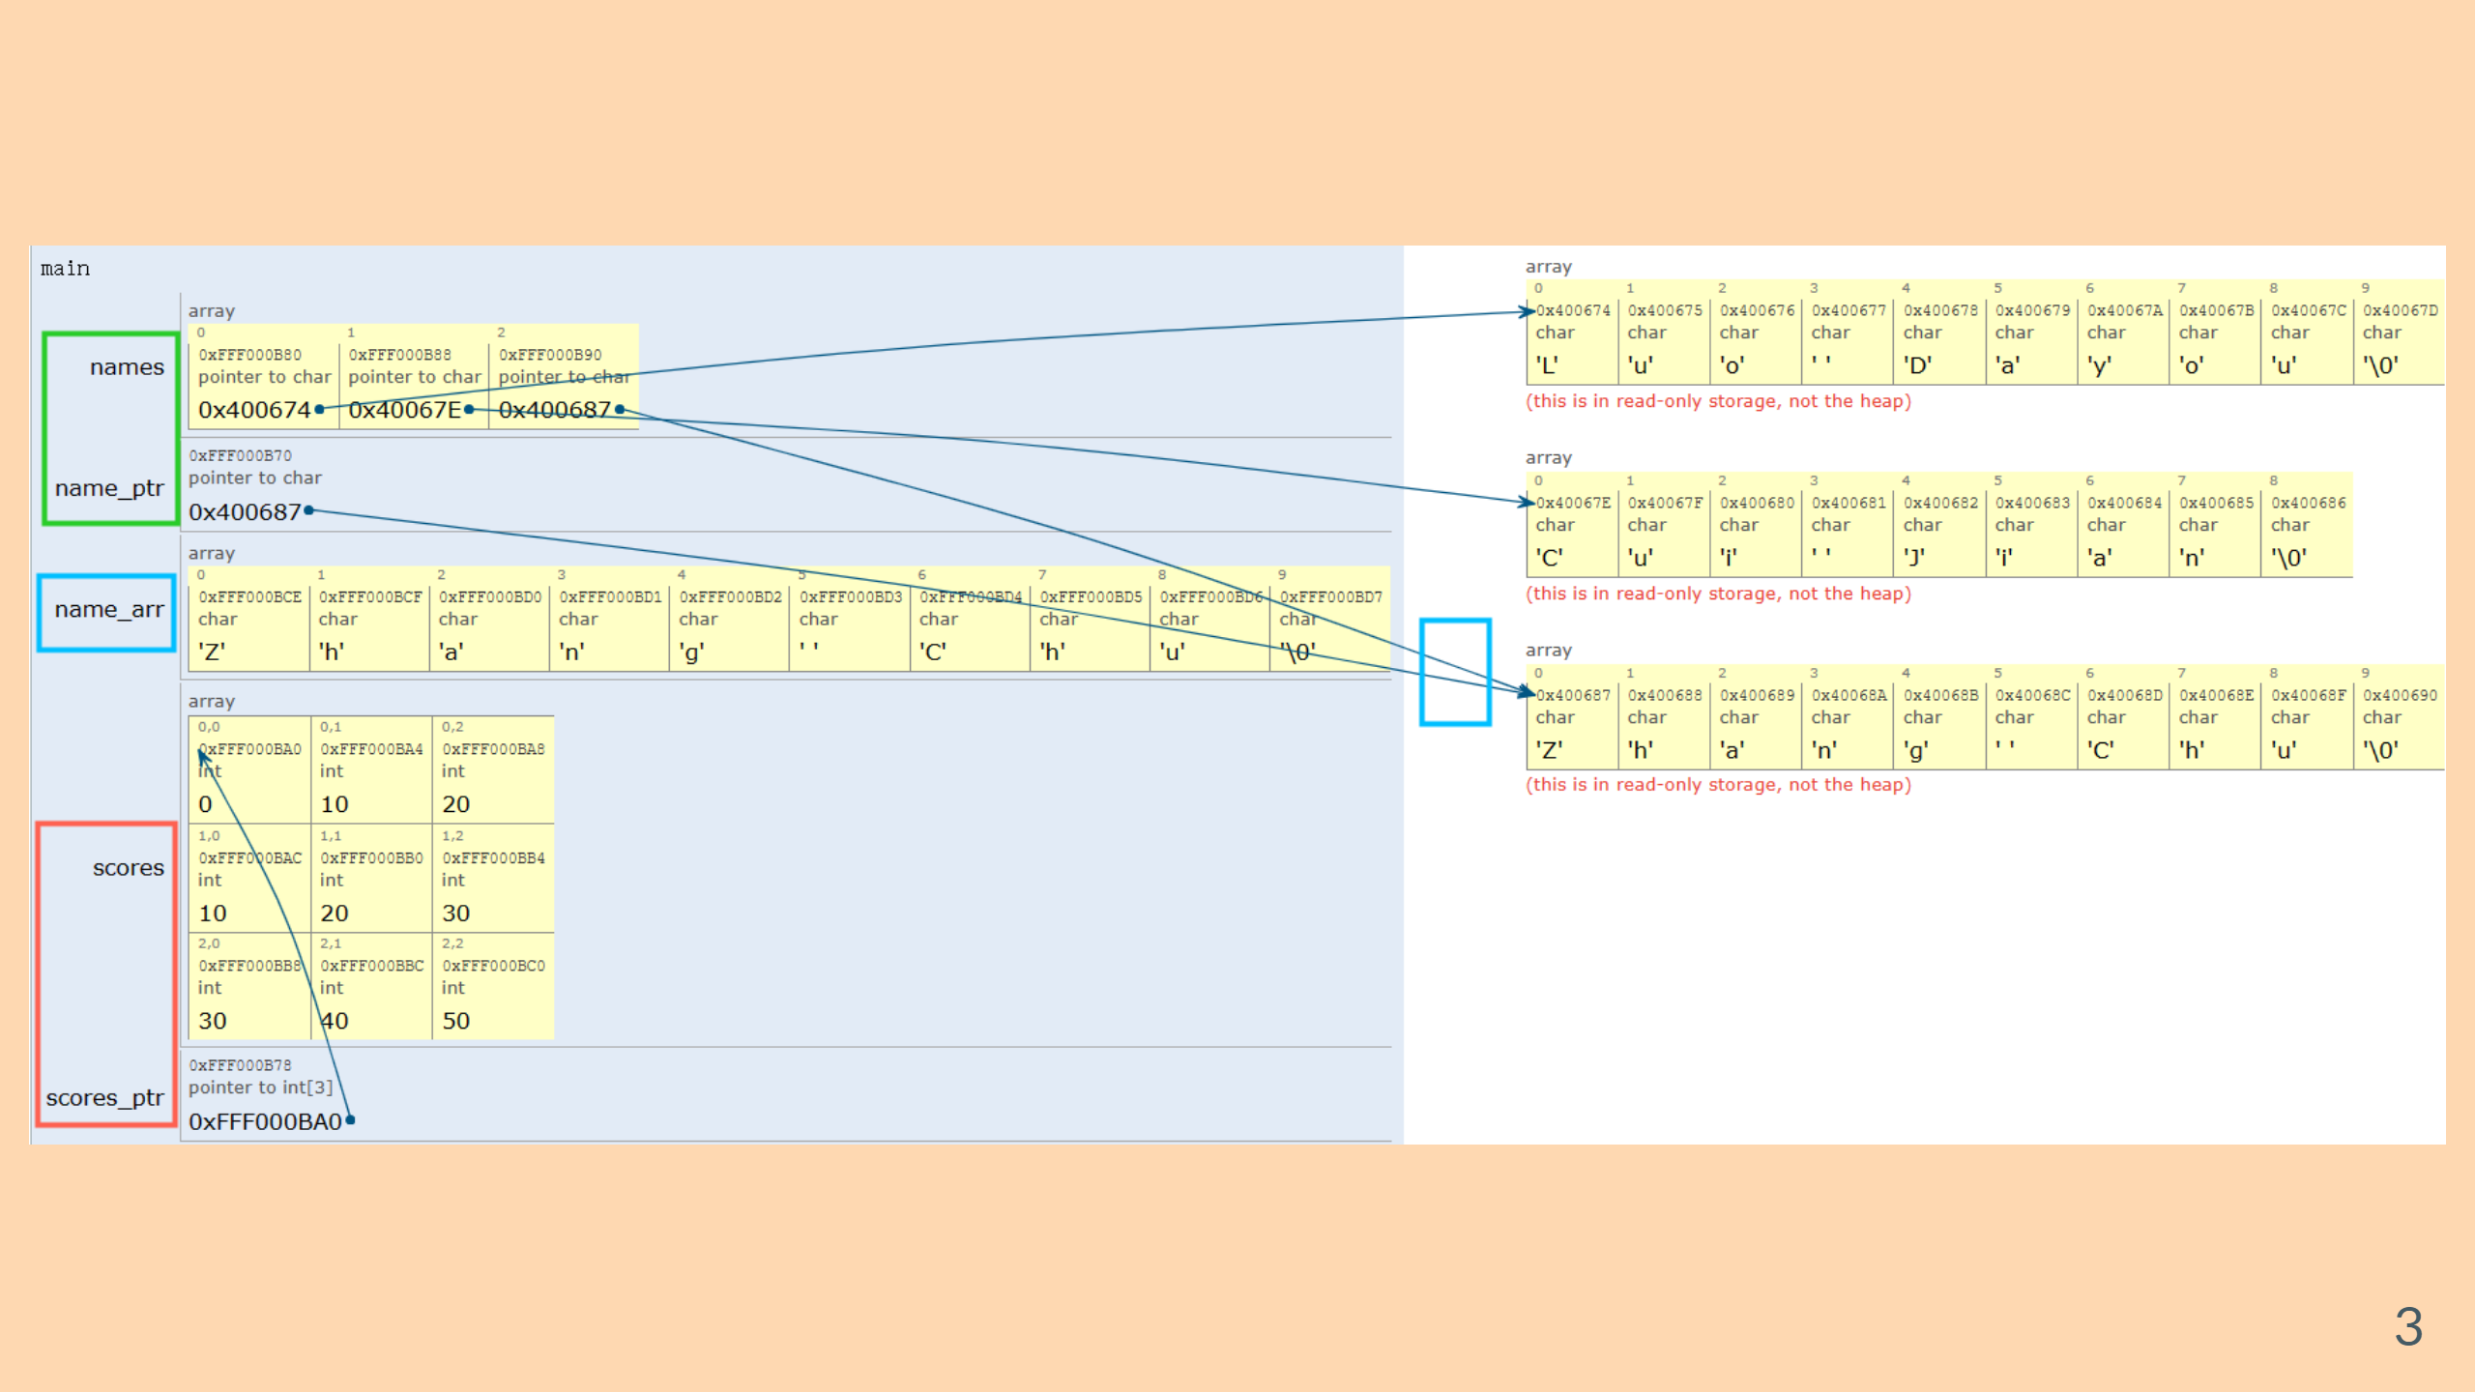

Slide 4
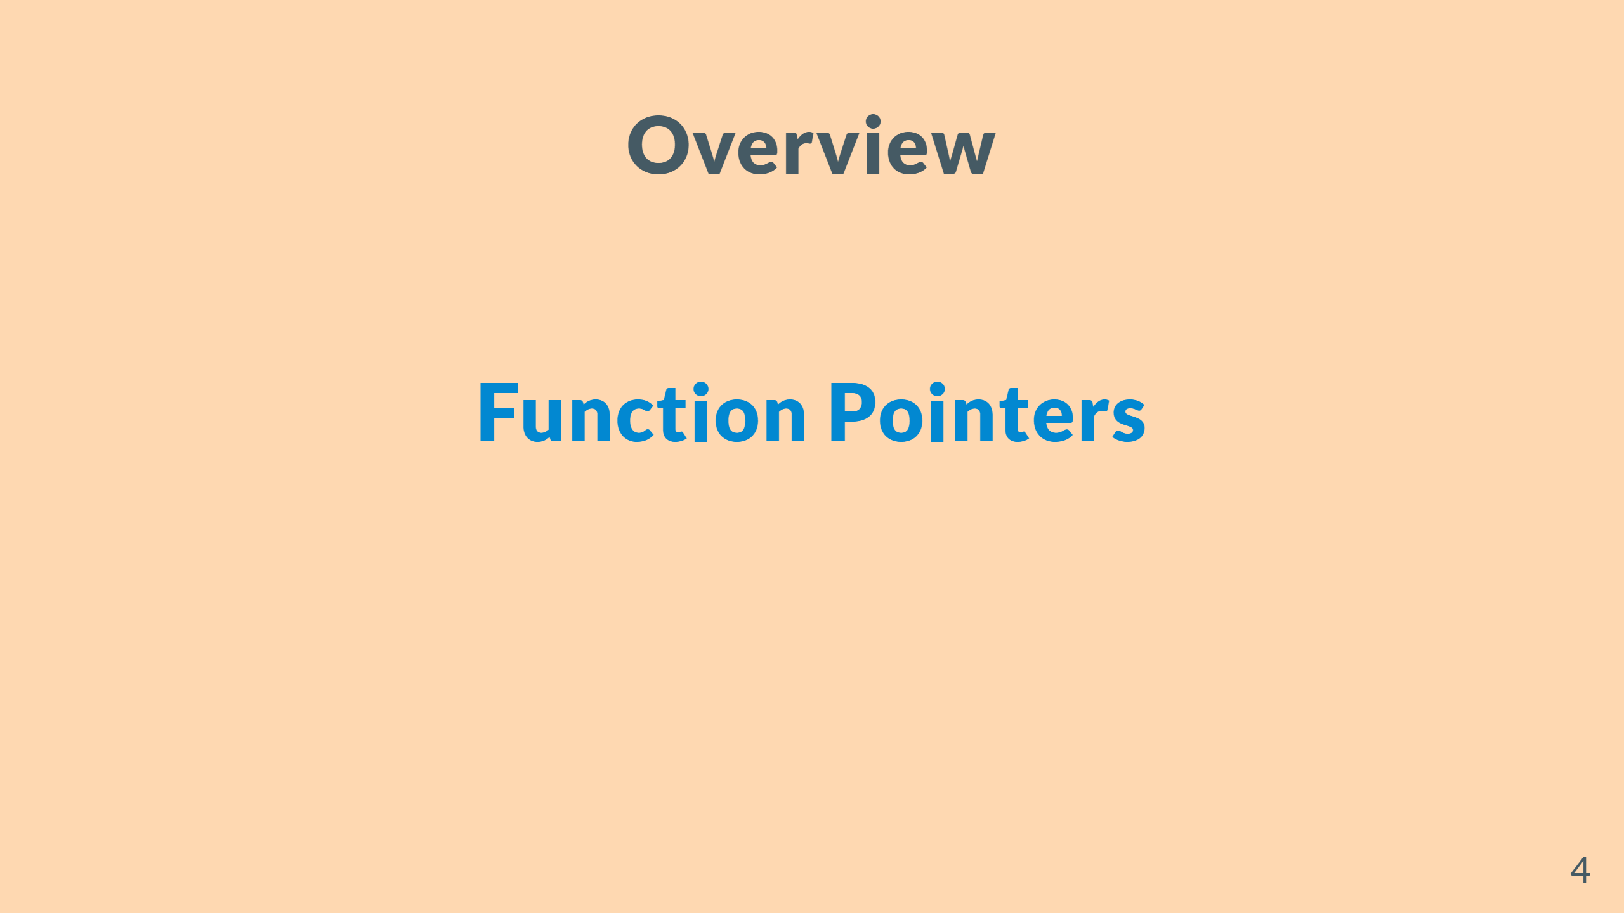

Slide 5


Slide 6


Slide 7
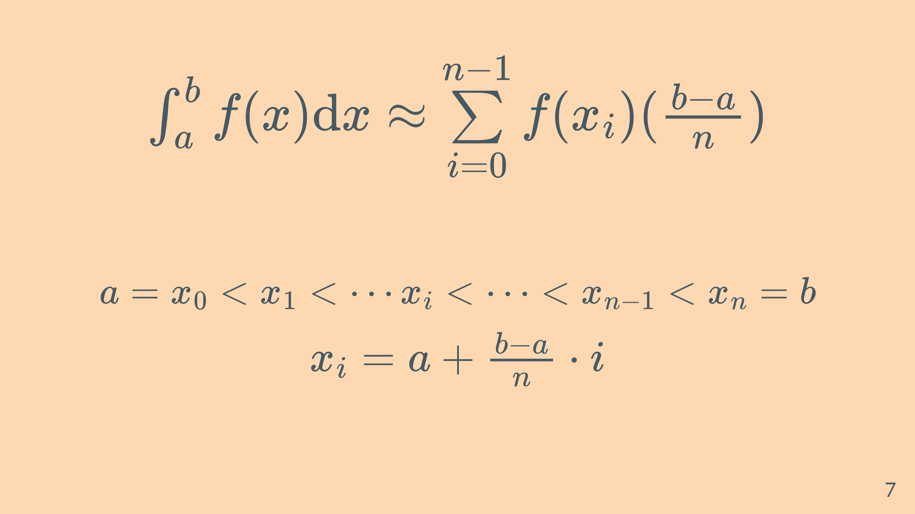

Slide 8

Notes:
![w:420](figs/fp-simplied.jpg)

Slide 9


Slide 10


